Slide 1

A Lightweight and Reliable Automated Patching System
UY Scuti Team
Ahmed Fathy, Software Engineer

Slide 2
Introduction
Scuti automates the patching process for a group of Virtual Servers, handling updates ranging from basic operating system upgrades to customized scripts (customized patching).
It offers various strategies for updating servers:
Sequential updates: it updates one server, waits until it is up and start the next … etc.
Batch updates: it updates a set of servers and start the next batch once the first is up and running.
Percentage-based updates: it updates a certain percent like 10 % at a time.
This strategies to ensure optimal availability.

Slide 3
Why Scuti
Increased Productivity by automating the boring stuff like systems patching.
Enhanced Security: Applying patches in a timely manner helps prevent security breaches and other issues that may arise.
Automating regular services upgrades in a big environments where changes take days to be rolled out to all servers.

Slide 4
Scuti named after UY Scuti, The red supergiant star with a volume nearly 5 billion times that of the sun.

Slide 5
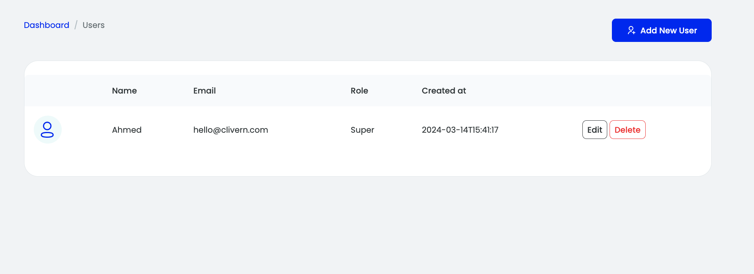
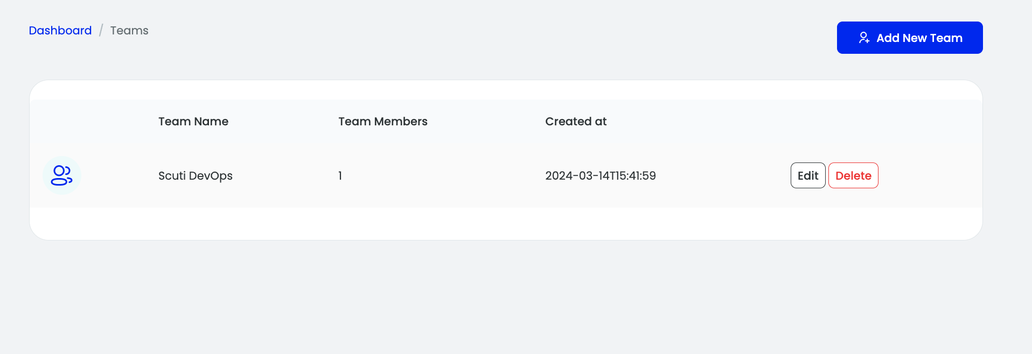
Users & Teams
Screenshots
From the management dashboard, you can create Users.
Also you can create teams and assign users to different teams

Slide 6
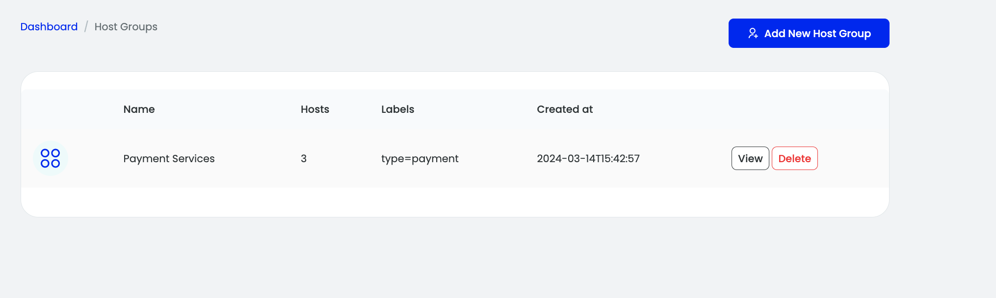
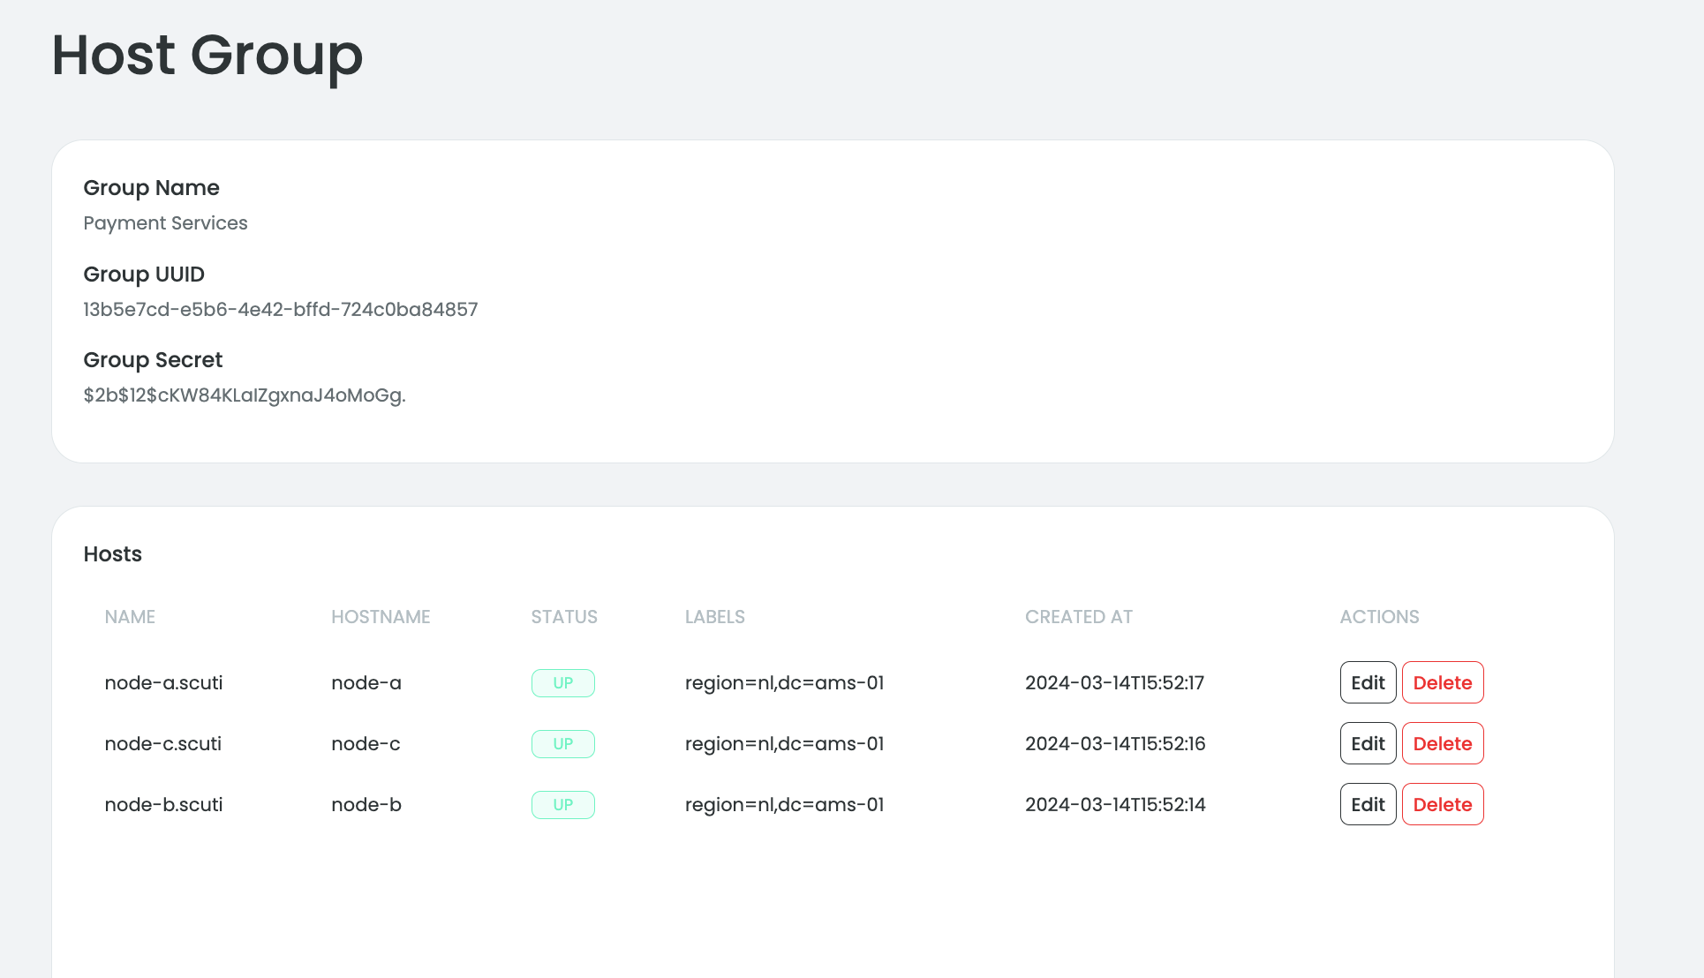
Host Groups & Hosts
Screenshots
Hosts can be arranged under host groups.
Host groups and hosts can be labeled to be selected later during deployment (Patching Job).

Slide 7
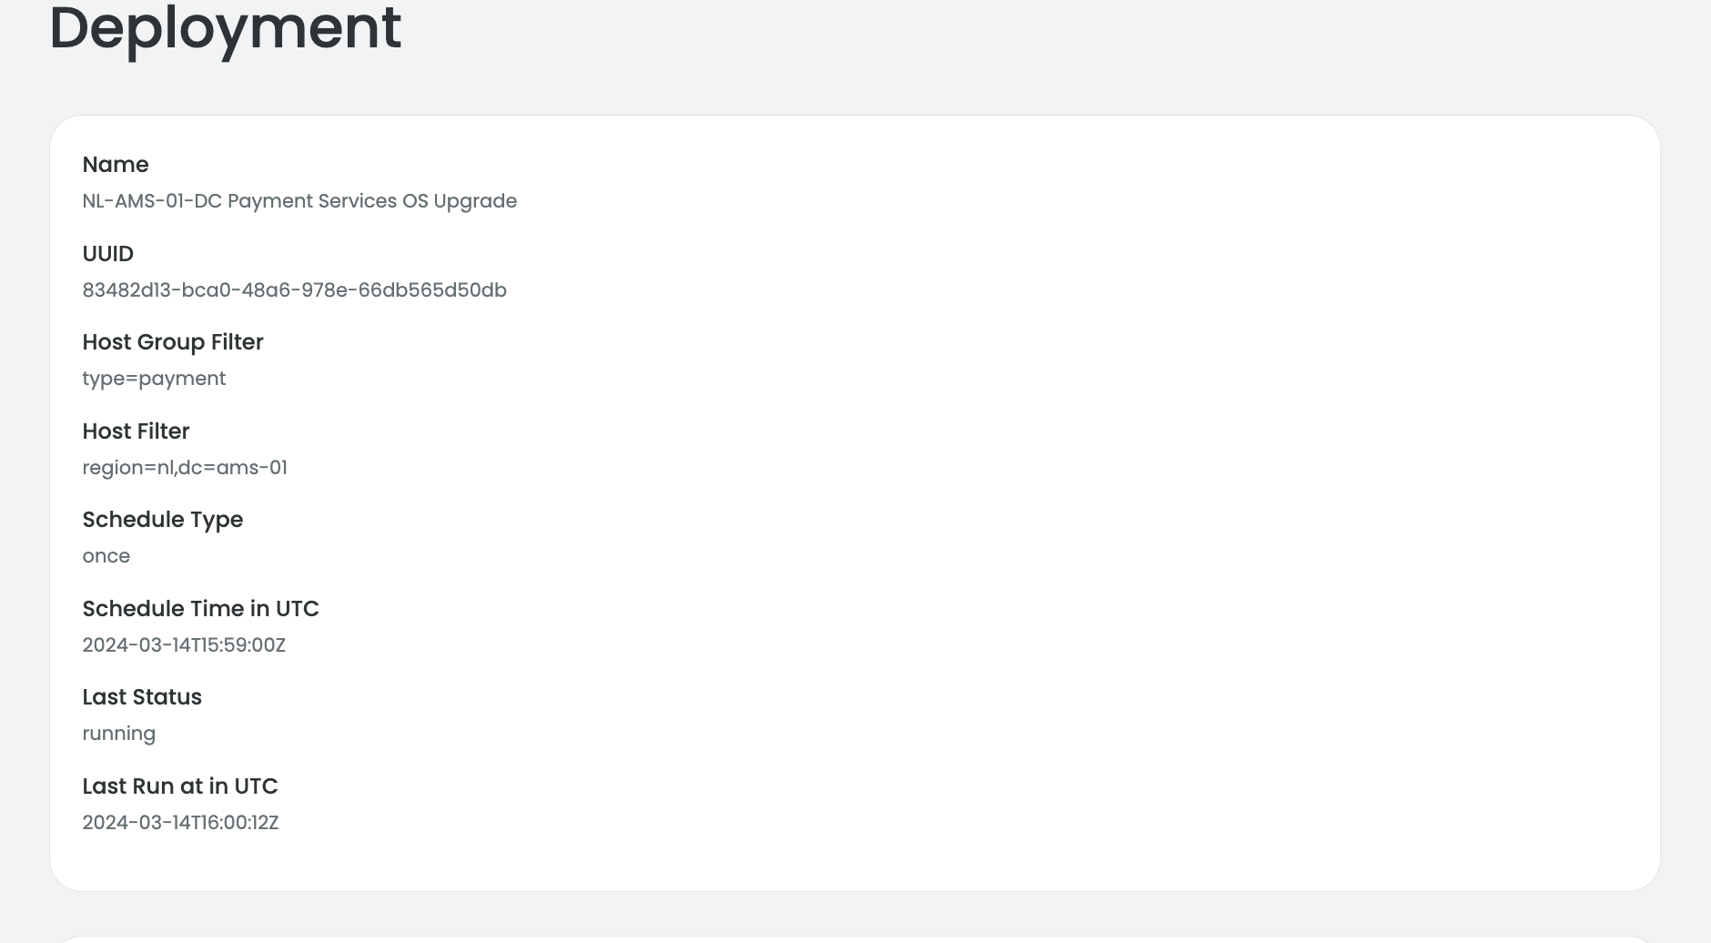
Deployments
Screenshots
Here is a deployment to upgrade NL hosts running in AMS-01 DC using filters.

Slide 8
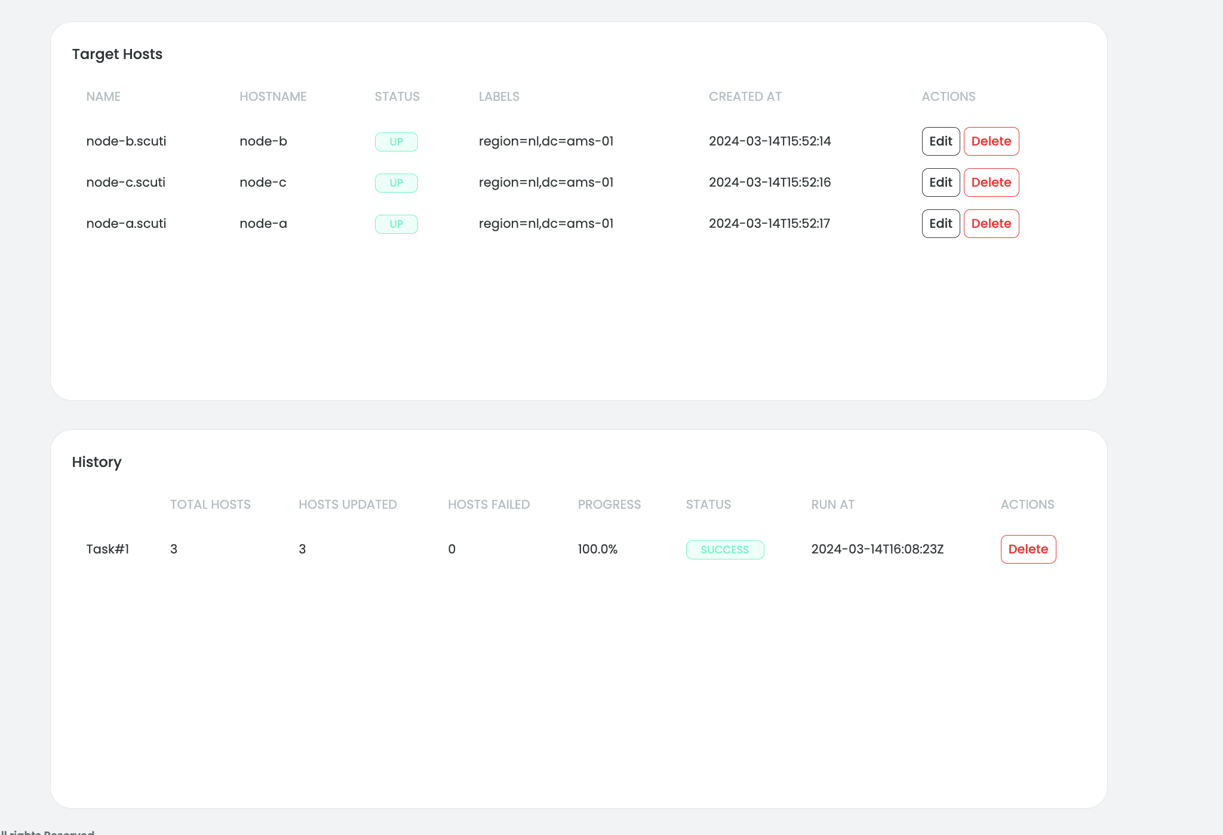
Deployments cont.
Screenshots
Deployment started for 3 hosts

Slide 9
Deployments cont.
Screenshots
Deployment started for 3 hosts

Slide 10
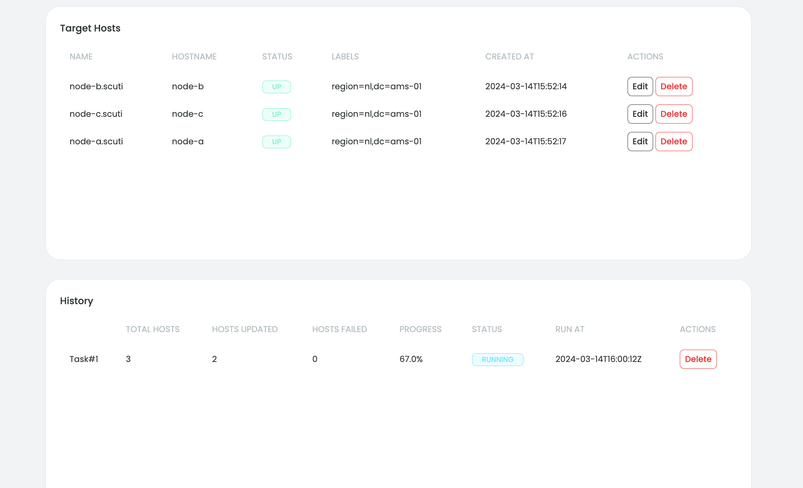
Deployments cont.
Screenshots
When the deployment schedule comes, a task will start to update the hosts.
Current progress and previous tasks shown in the deployment page in the mgt dashboard.

Slide 11

Live Demo

